Slide 1
Million Link (China) Investment Ltd. Projector：Hill Summer
China Steel
Demand and behavior
-- for Fastmarket Ferroalloys 2023 Prague

Slide 2
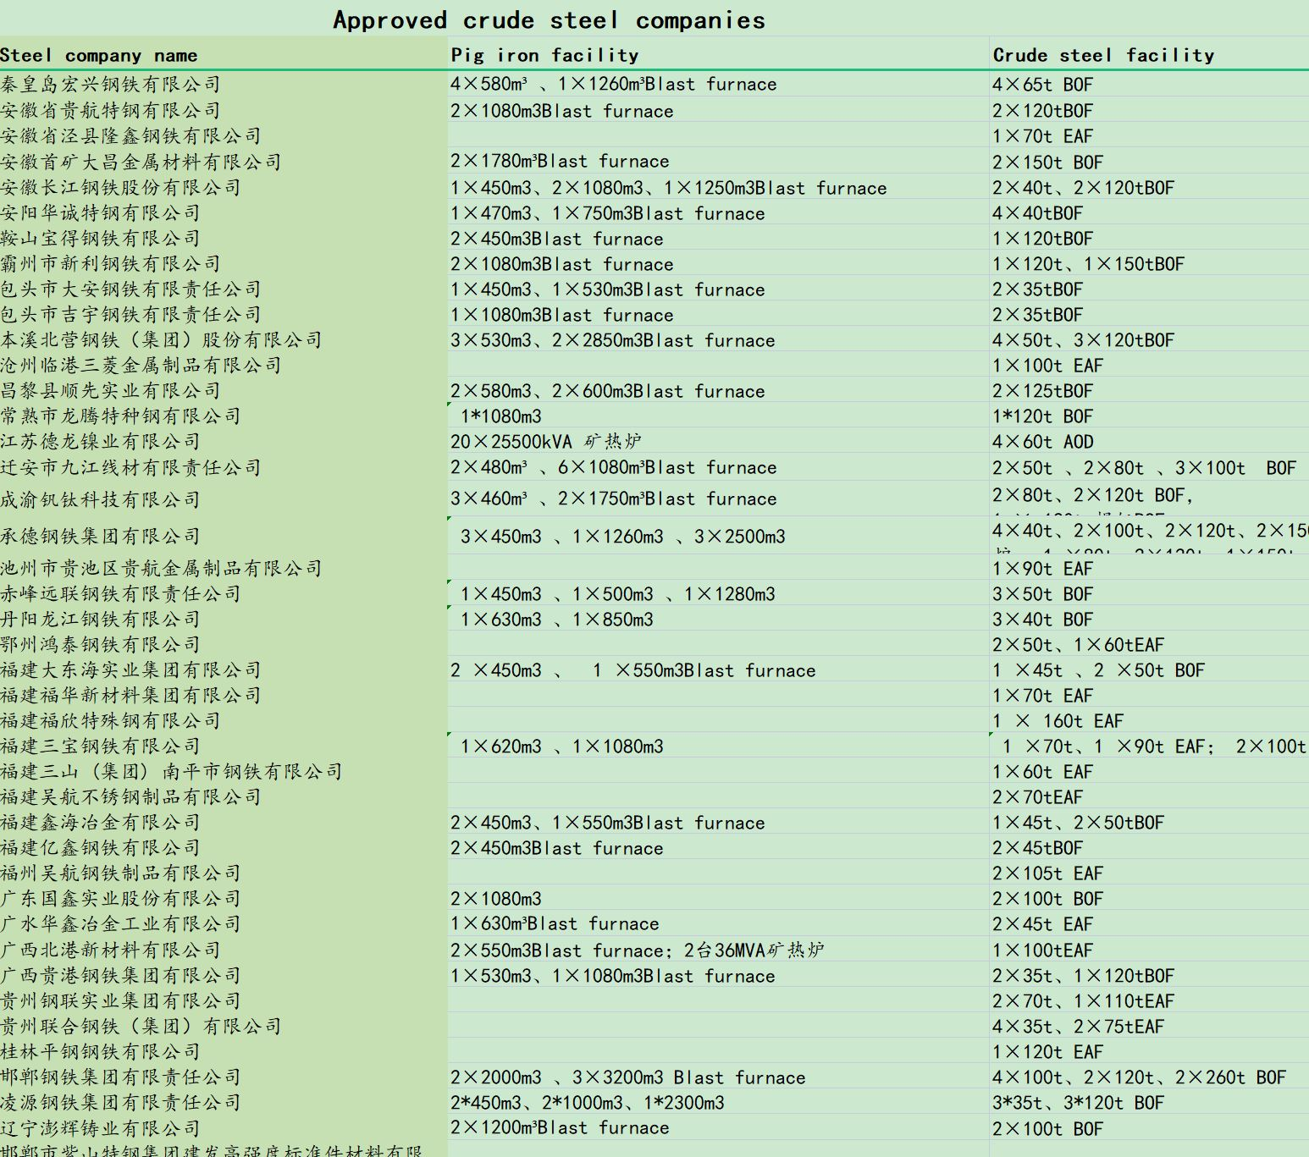
Competitive structure
01
Shagang
56.81mmt
Shougang
35.43mmt
Xinxin Pipe
Anyang
9.5mmt
Jingye
15.38mmt
HBIS
41.64mmt
SinoGiant
14.34mmt
Puyang group
Zenith
12.76mmt
Donghai
10.42mmt
Tsingshan
12.37mmt
Shandong Steel
28.25
Jinan Steel Group
Jiuquan
8.75mmt
Jianlong
36.71mmt
baotou Steel
16.45mmt
Baowu
130.05MMT
14%
Delong
27.82mmt
Shaanxi Steel
12.39mmt
Hunan Valin
26.21mmt
Nova Wu’an Group
Citic Pacific
13.97mmt
Rizhao Steel
13.57mmt
Ansteel
55.65mmt
Sanming
11.4mmt
Shenglong
12.16mmt
Fanda
19.98mmt
Liuzhou
18.83mmt
200 independent steel plants
CR10 41.50%
Others 58.50%

Slide 3
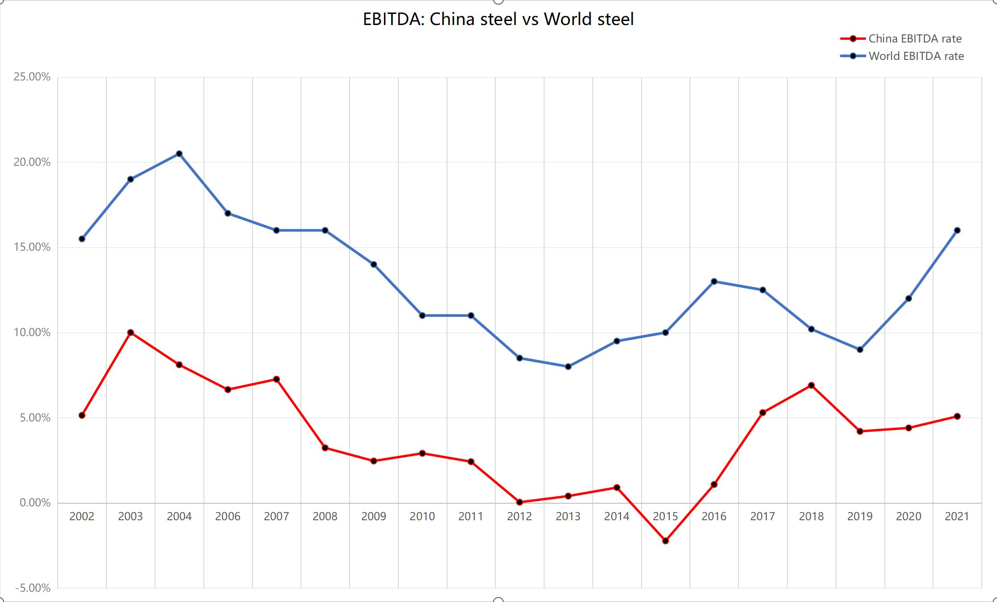
Financial struggle
02

Slide 4
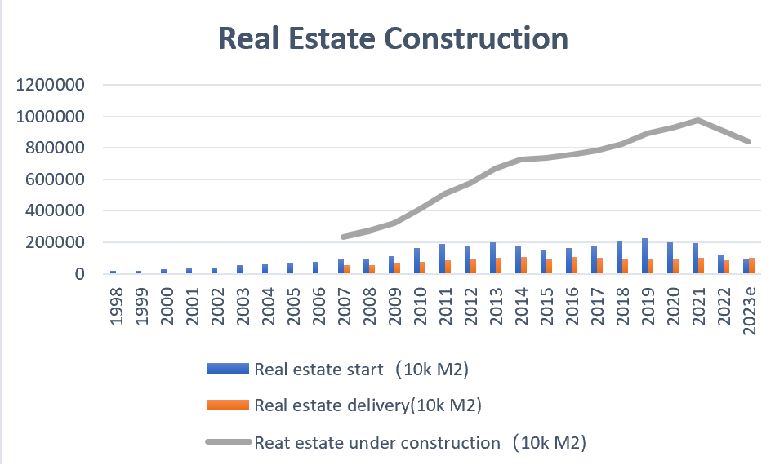
Demand declines
03

Slide 5
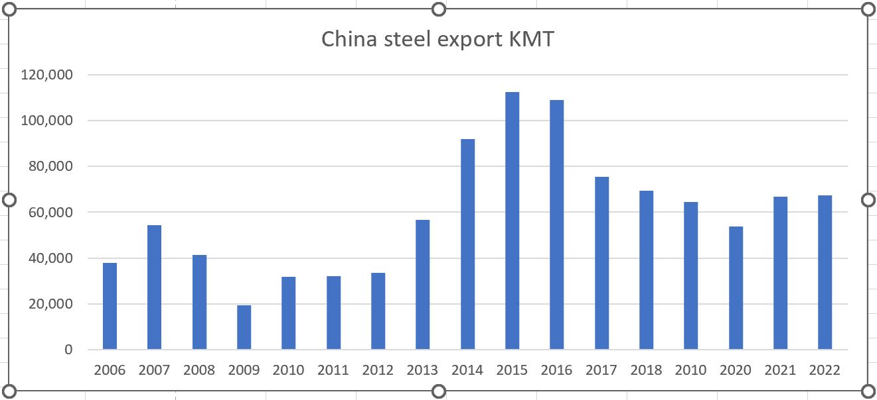
Export-good hope
04

Slide 6
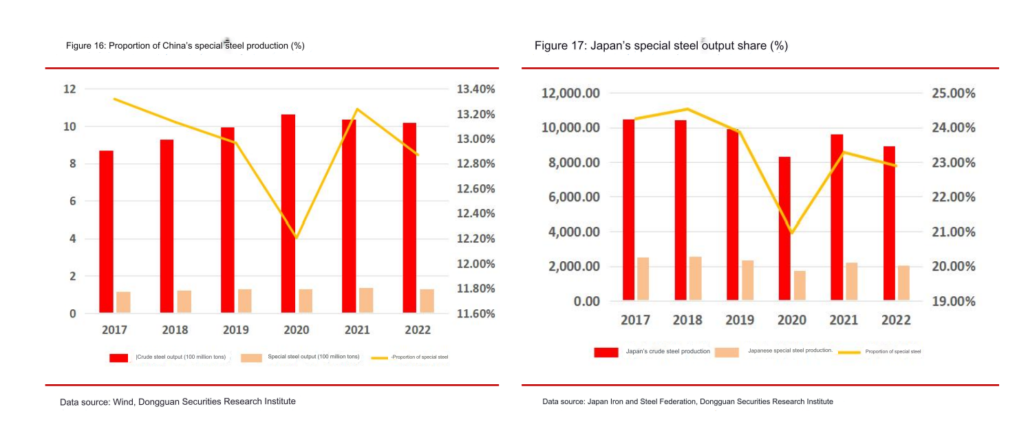
Import substitution, high yield business
05

Slide 7
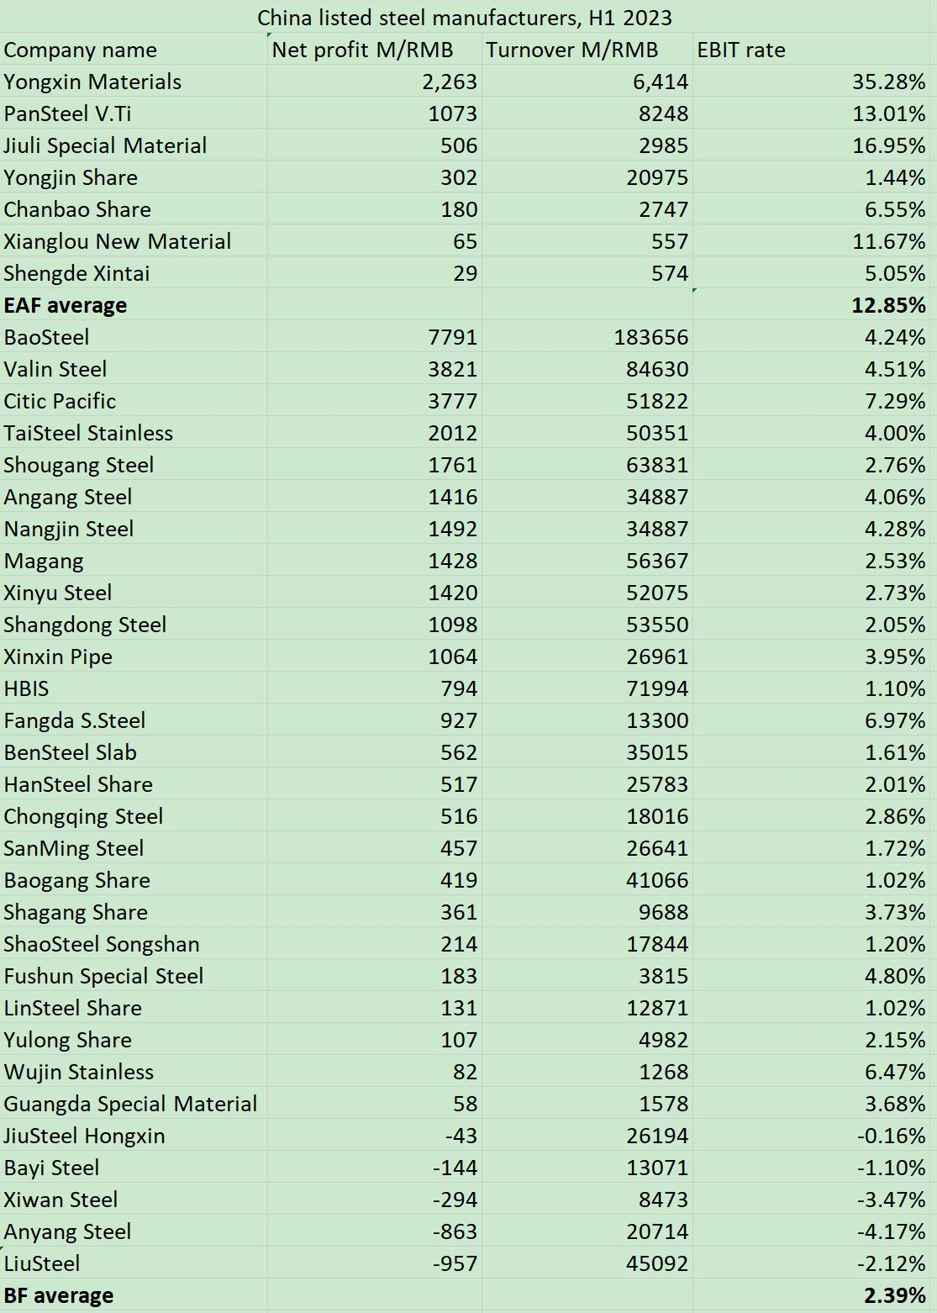
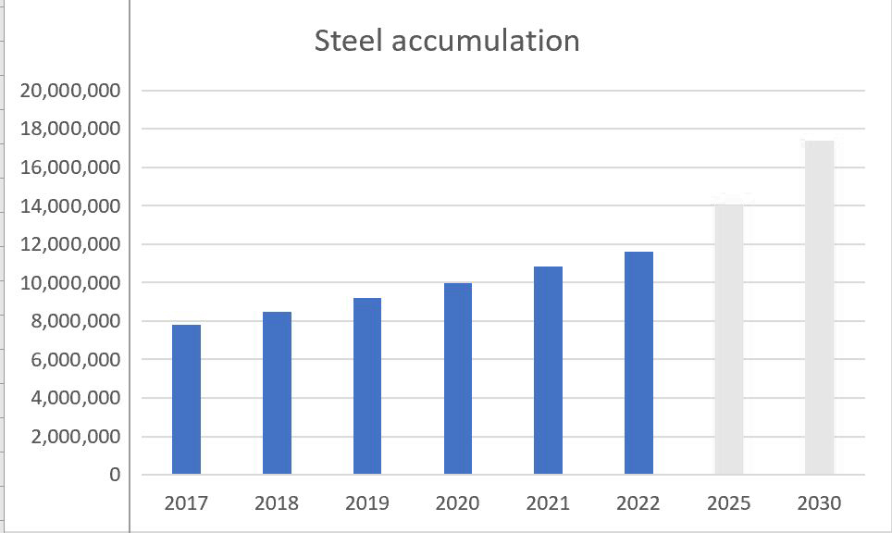
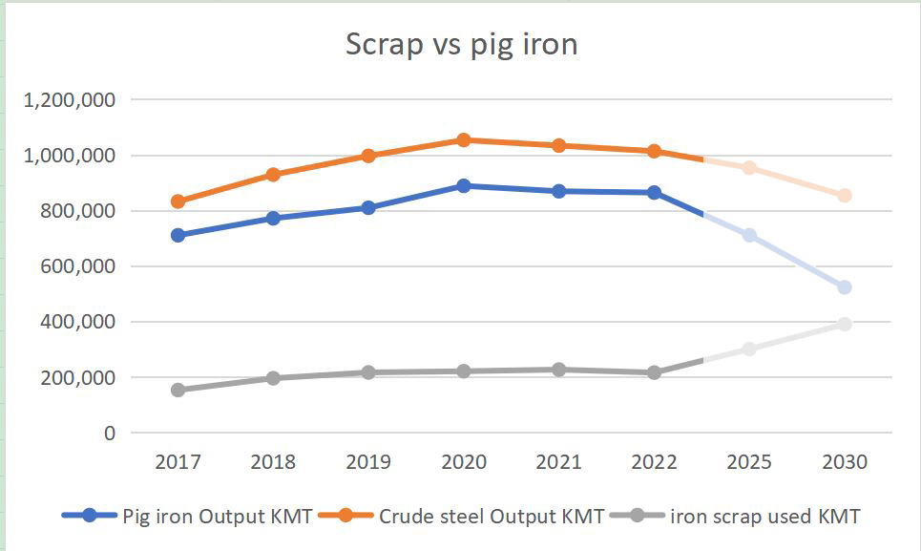
Rise of EAF
06
2025, 2030 用虚线，2个表都是

Slide 8
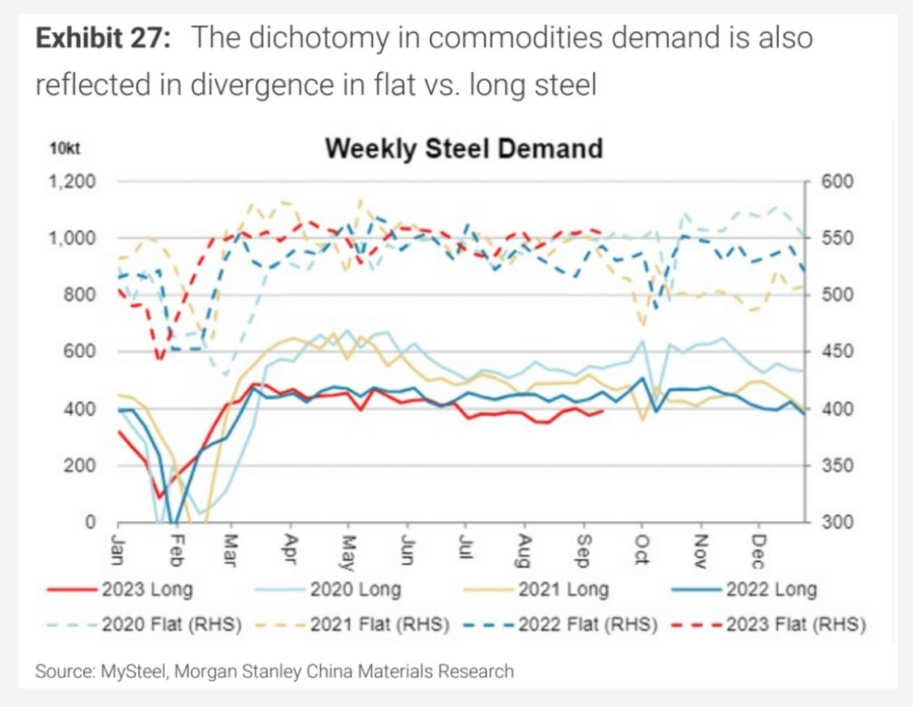
Transit from long to flat
07

Slide 9
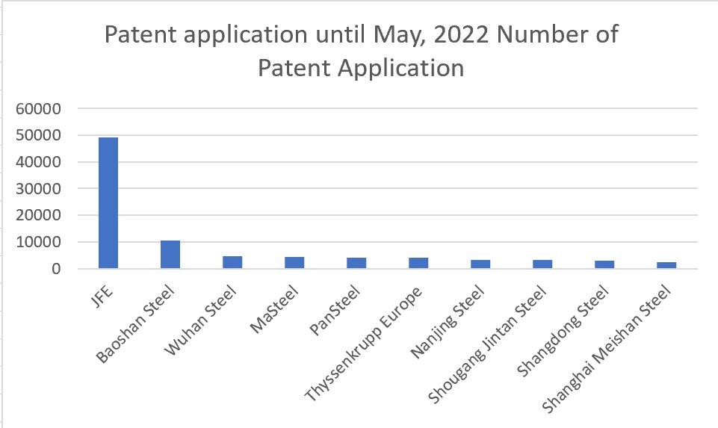
R&D, right track
08

Slide 10
Overseas investment and collaboration
09

Slide 11
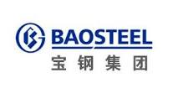
Iron ore-power transit
10

Slide 12
Benchmark of Ferroalloys
11

Slide 13
ESG-winner
12
ESG credit level | Debt default rate
A | 0.28%
B
C
D | 3.58%
Source: Deloitte Green Quantum, from 2015-2022

Slide 14
China steel metamorphosis
13
Higher
Quality
Fair
Yield
Lower
Emission
Supply Chain
millionlink.com Projector：HillSummer@millionlink.com
Disclaimer
Million Link and/or its subsidiaries endeavour to ensure the accuracy and reliability of the information provided, but do not guarantee its accuracy and reliability and accept no liability (whether in tort or contract or otherwise) for any loss or damage arising from any inaccuracy or omission or from any decision, action or non-action based on or in reliance upon information contained in this presentation.

