Slide 1
Million Link (China) Investment Ltd. Projector：Hill Summer
China Steel Metamorphosis
Myth of business scale
-- for CRU Ferroalloys 2023 Orlando

Slide 2
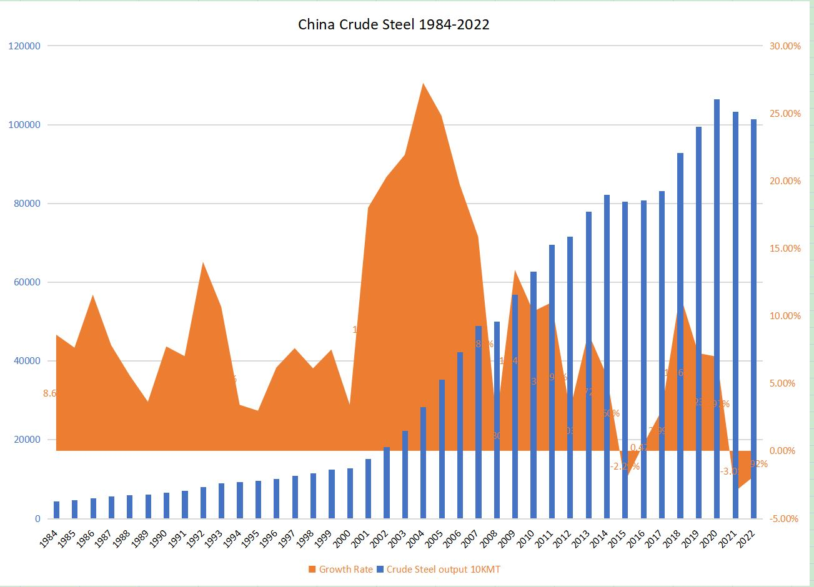
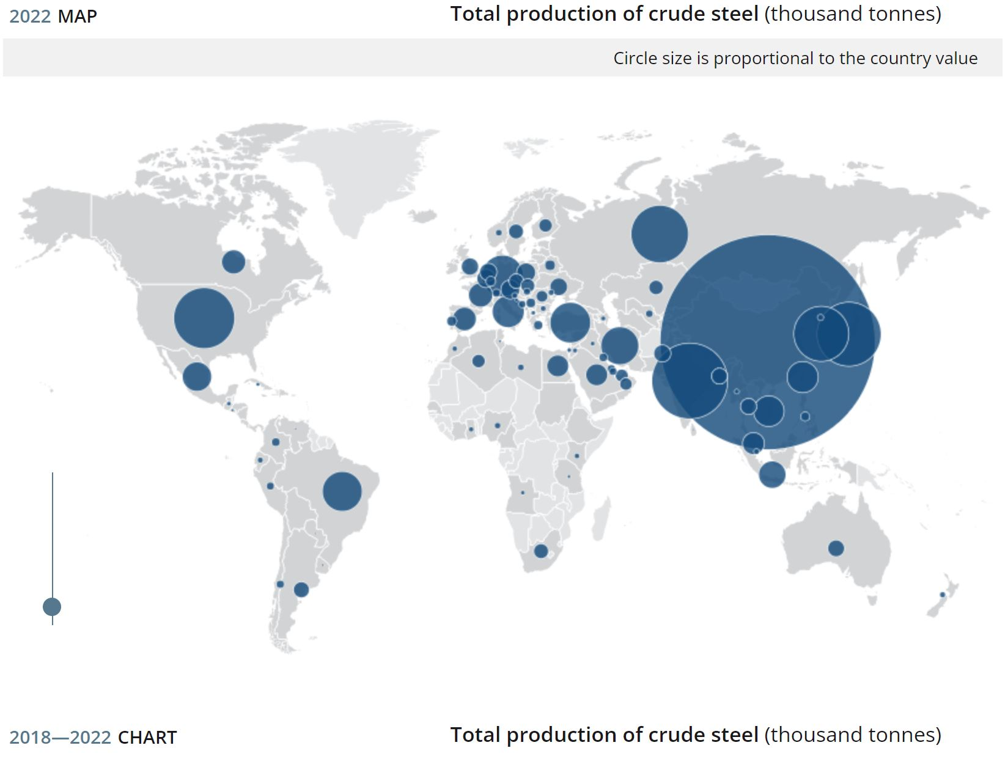
China Steel Miracle
01

Slide 3
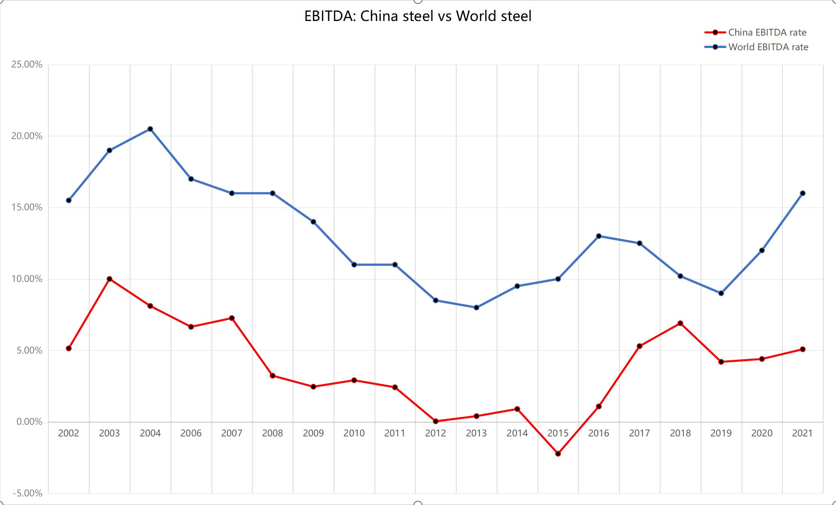
Investors’ Struggle
02

Slide 4
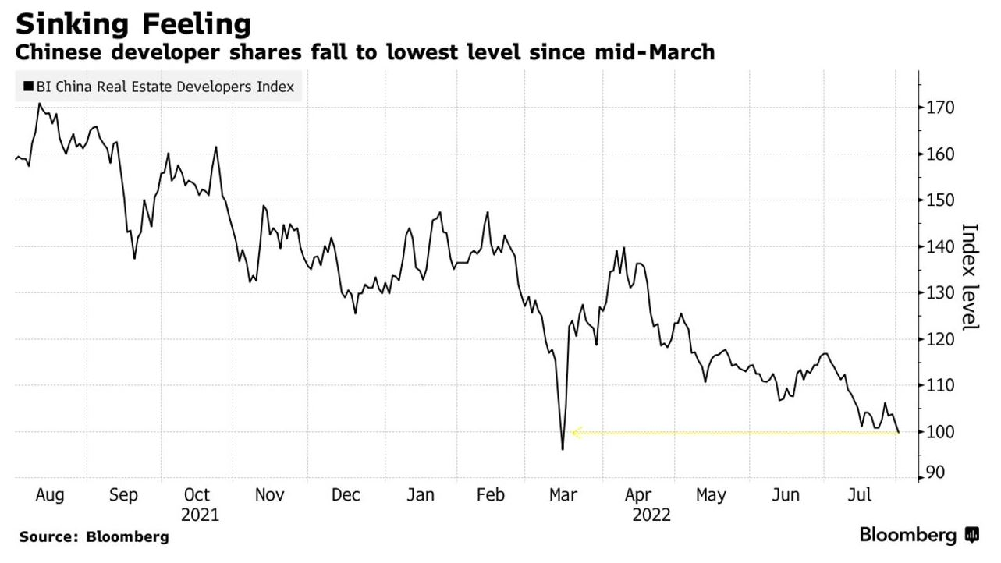
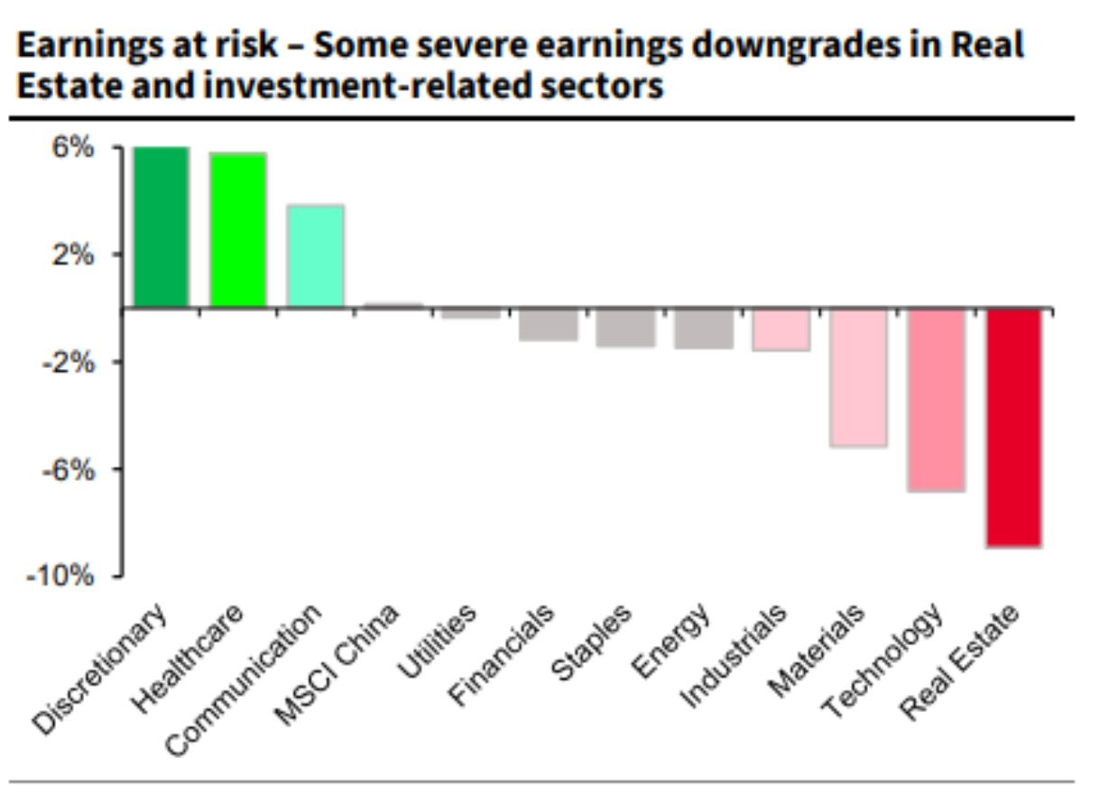
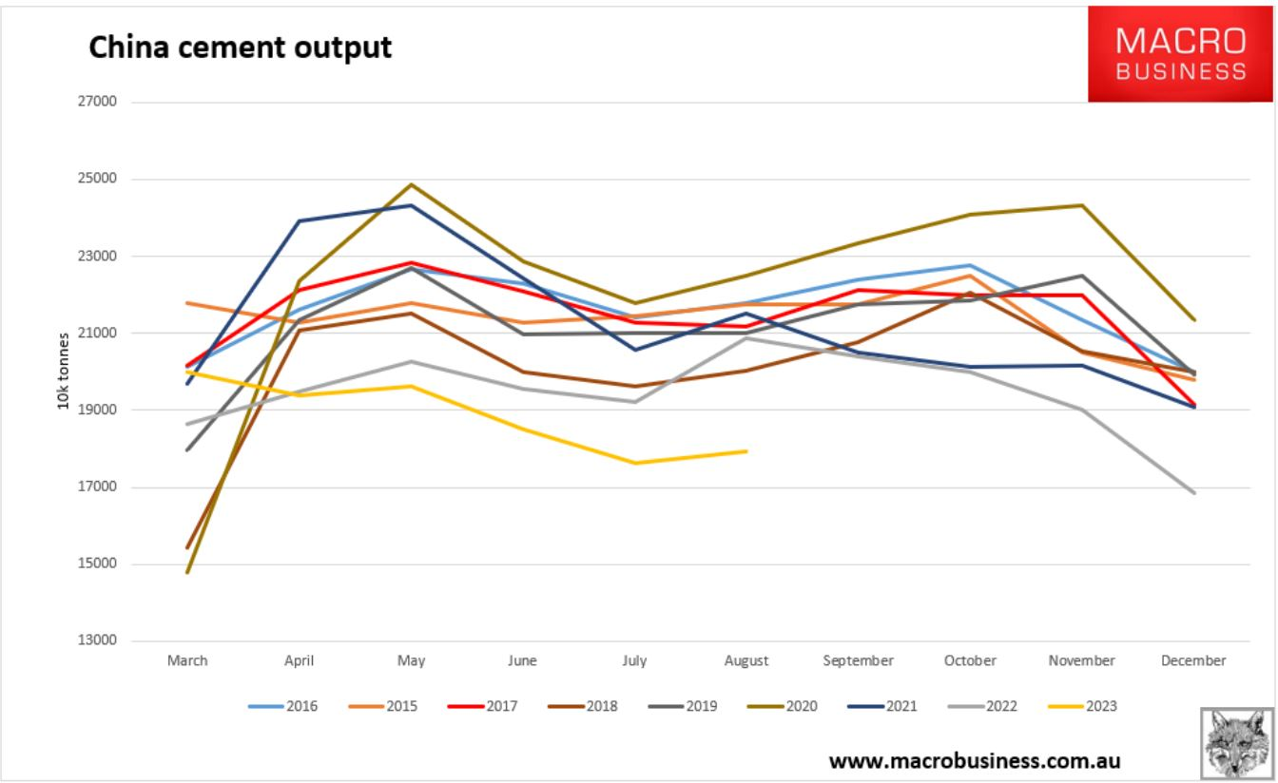
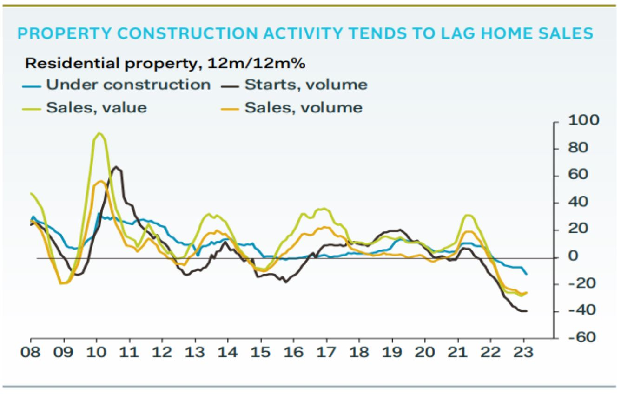
Challenge Ahead
03

Slide 5
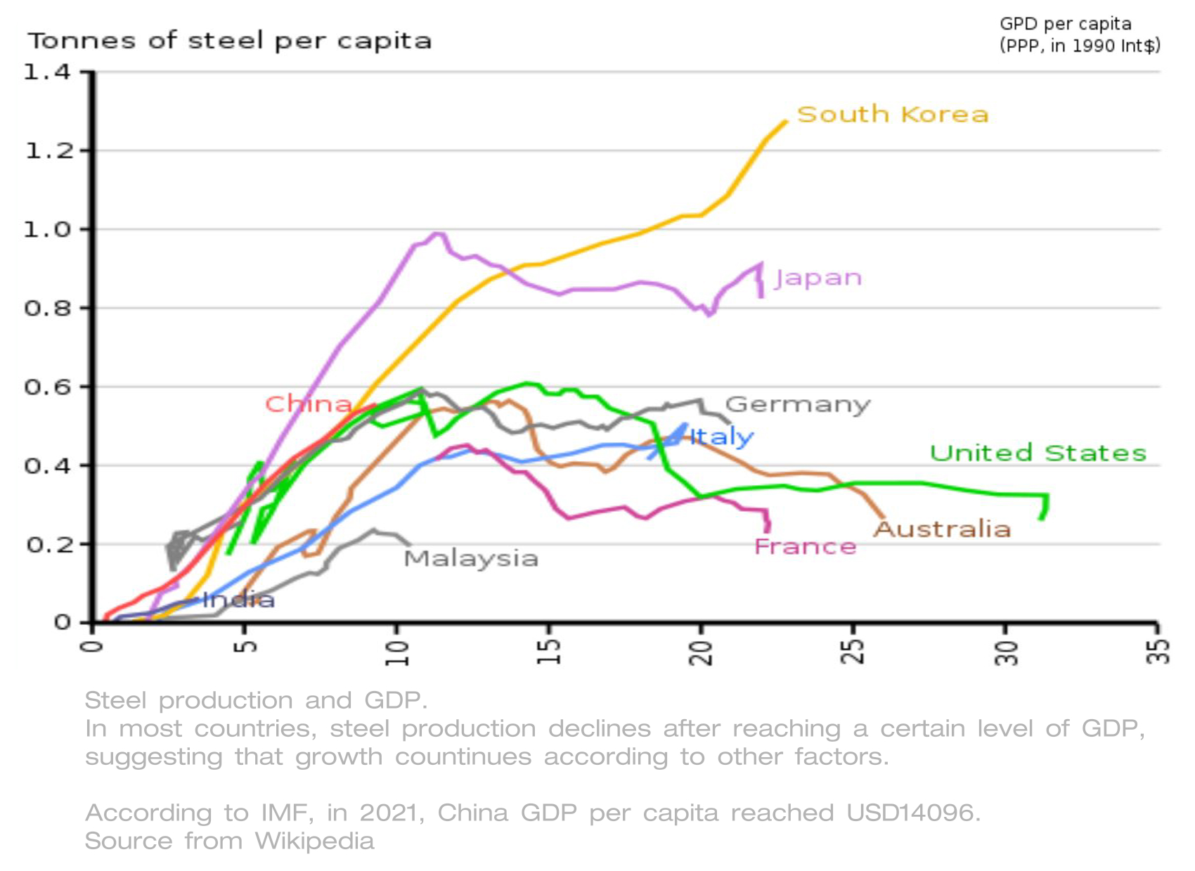
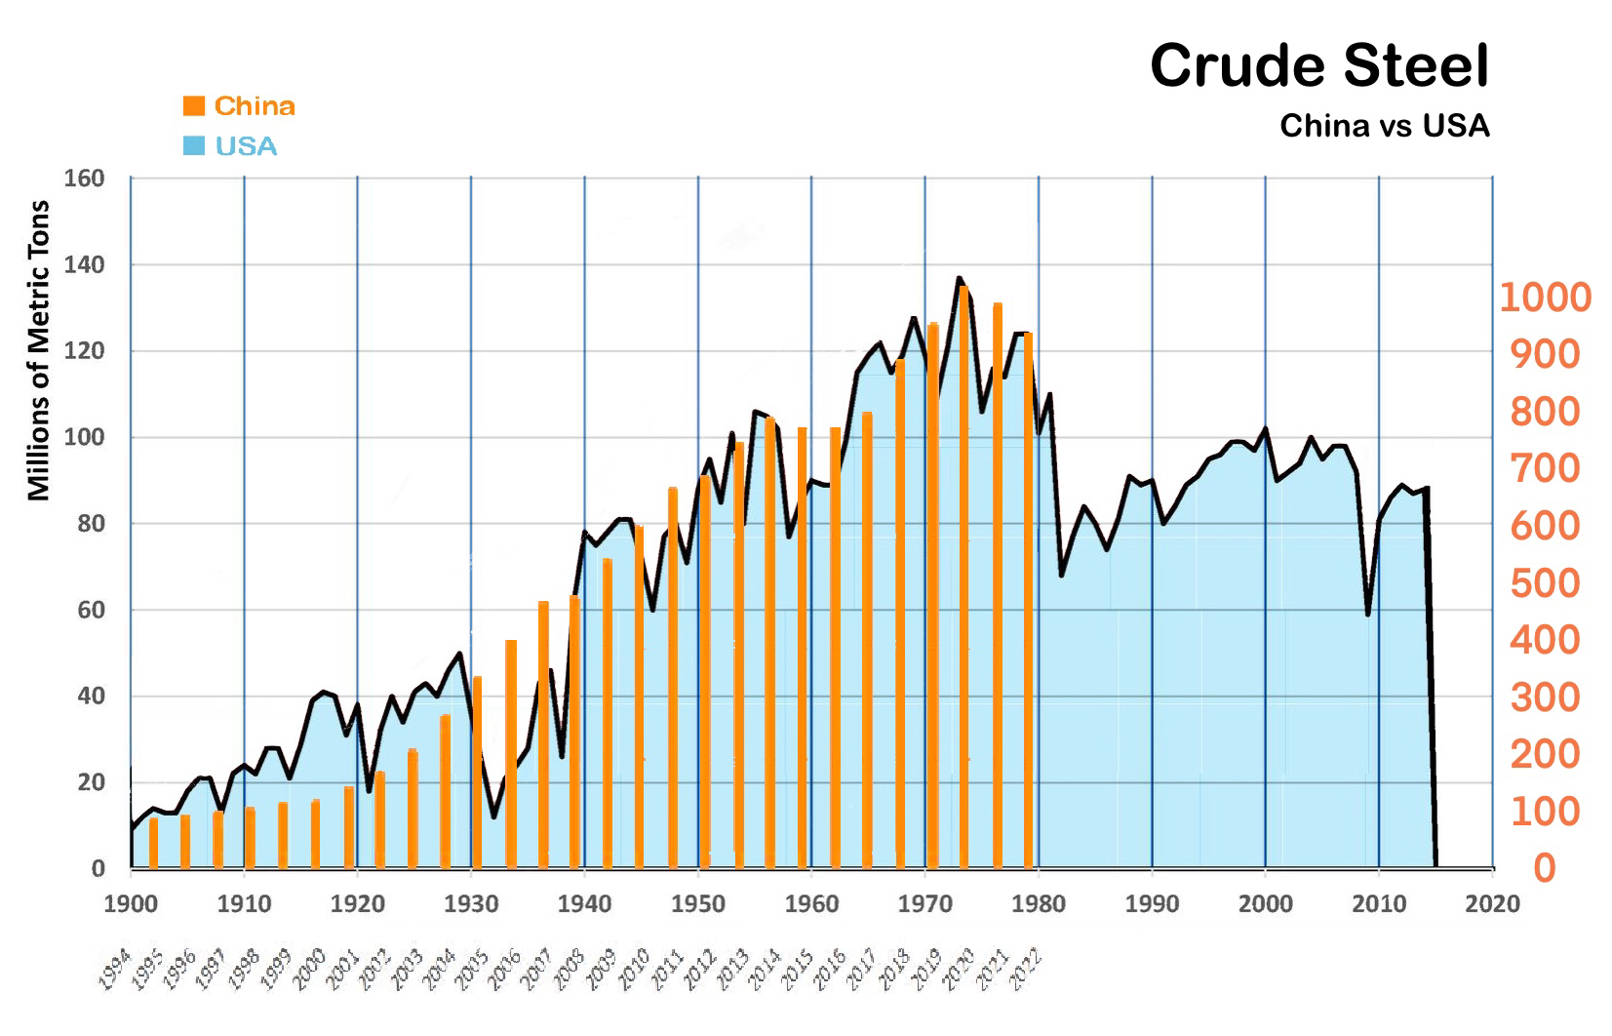
Future is Given
04

Slide 6
Priority-Higher Market Share
05
Requests steel manufacturers reduce crude steel output voluntarily and collaborately in order to maintain stability of the market.
Strive to build Baowu into the most competitive steel material solution provider in the world, with a crude steel production capacity of more than 200 million tons, forming a group of steel products with high market share and controling over the market
Vision: Represent national industry, take the responsibility of the state, build most competitive steel enterprise.
Vision: Maitain the position of China fortune 500 and march to World fortune 500.

Slide 7
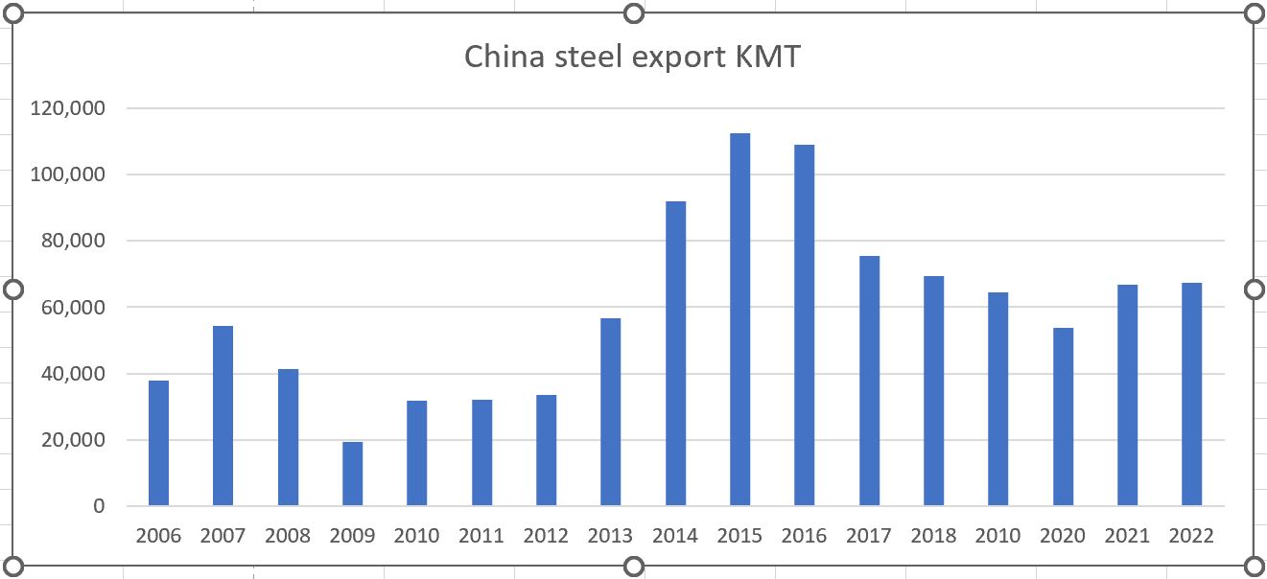
Priority-Export
06

Slide 8
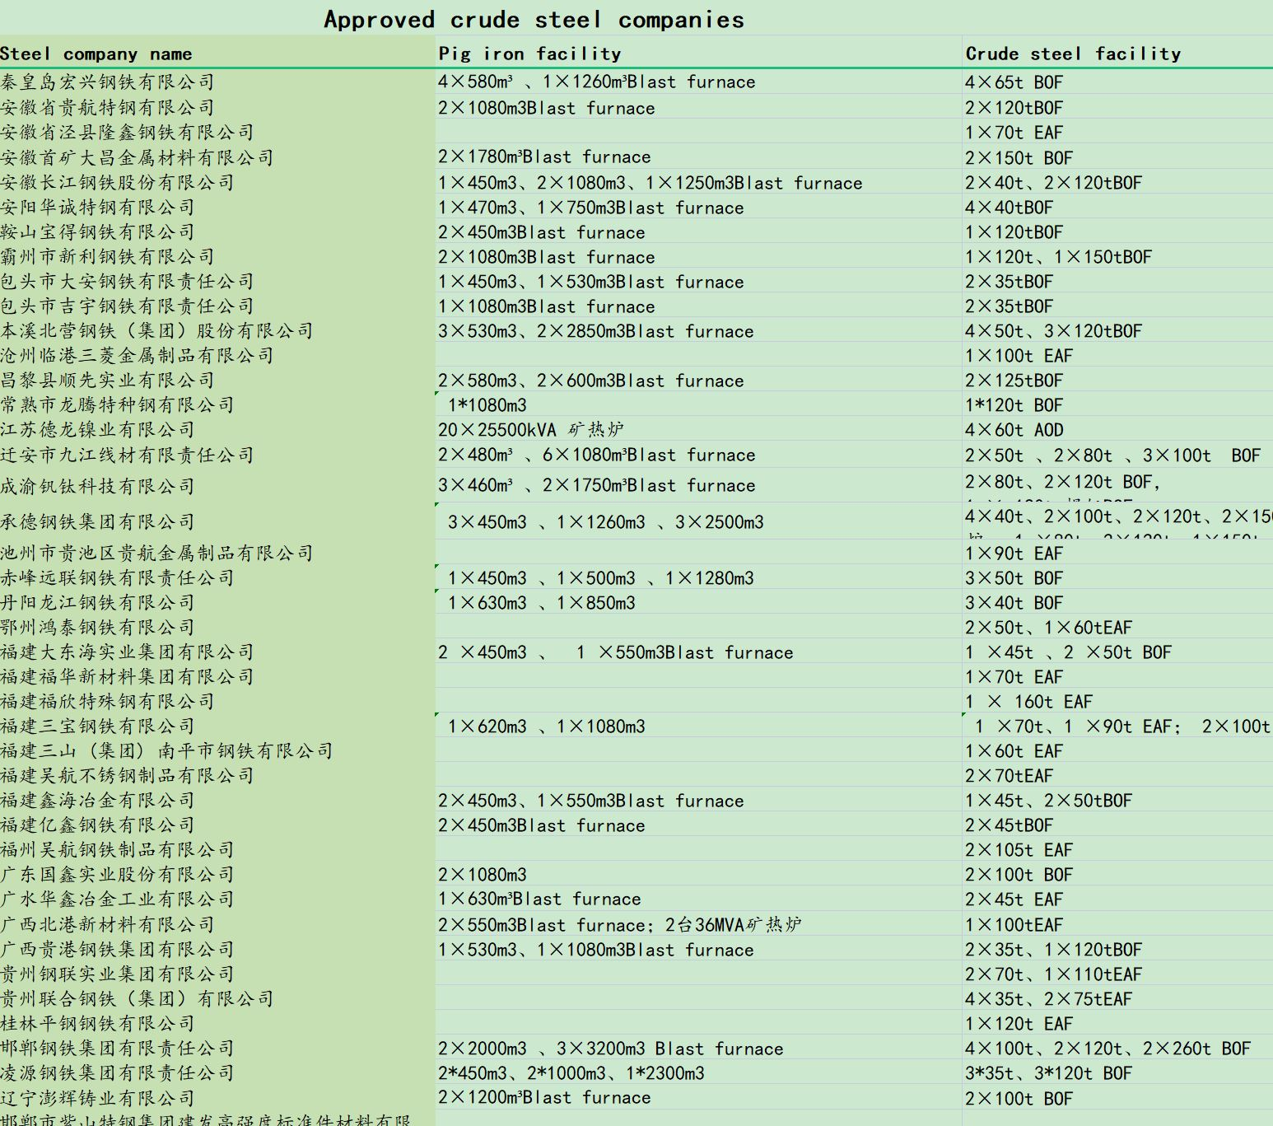
Priority-Road to Cartel
07
Shagang
56.81mmt
Shougang
35.43mmt
Xinxin Pipe
Anyang
9.5mmt
Jingye
15.38mmt
HBIS
41.64mmt
SinoGiant
14.34mmt
Puyang group
Zenith
12.76mmt
Donghai
10.42mmt
Tsingshan
12.37mmt
Shandong Steel
28.25
Jinan Steel Group
Jiuquan
8.75mmt
Jianlong
36.71mmt
baotou Steel
16.45mmt
Baowu
130.05MMT
14%
Delong
27.82mmt
Shaanxi Steel
12.39mmt
Hunan Valin
26.21mmt
Nova Wu’an Group
Citic Pacific
13.97mmt
Rizhao Steel
13.57mmt
Ansteel
55.65mmt
Sanming
11.4mmt
Shenglong
12.16mmt
Fanda
19.98mmt
Liuzhou
18.83mmt
200 independent steel plants
CR10 41.50%
Others 58.50%

Slide 9
Priority-Online Sales
08
Direct sales 38%
Distribution centre sells about 45%

Slide 10
Priority-Centralize Procurement
09
Obei.com.cn
44.5B Yuan
spare parts, engineering,equipment
More than 10,000 suppliers,
More than 800,000 commodity code
Baowu+

Slide 11
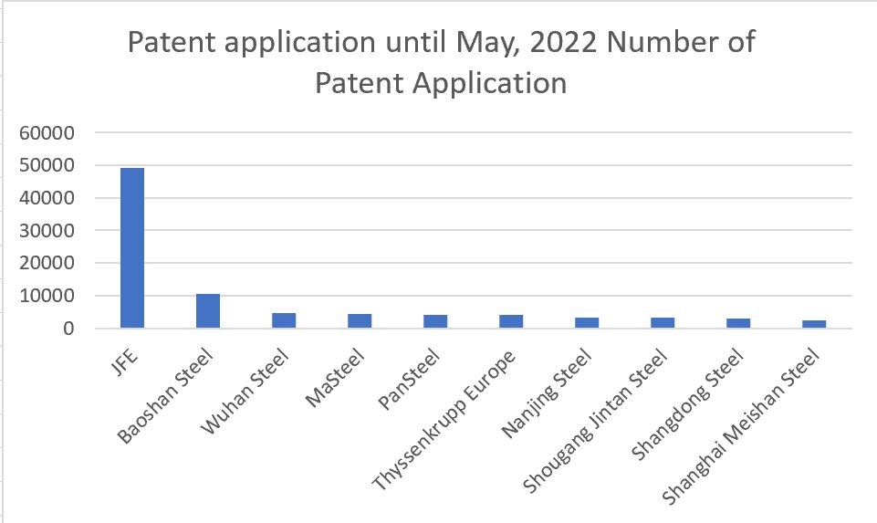
Priority-R&D
10

Slide 12
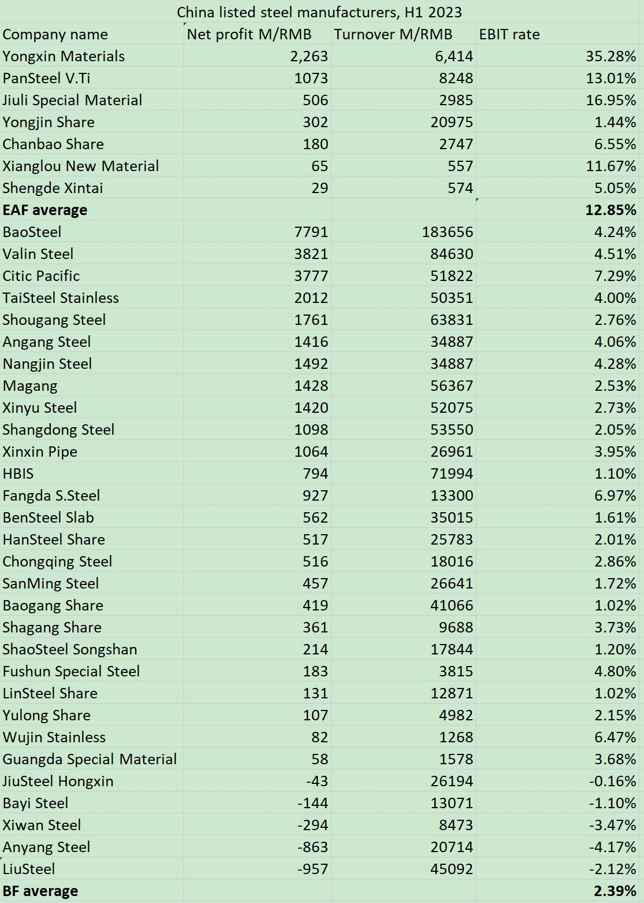
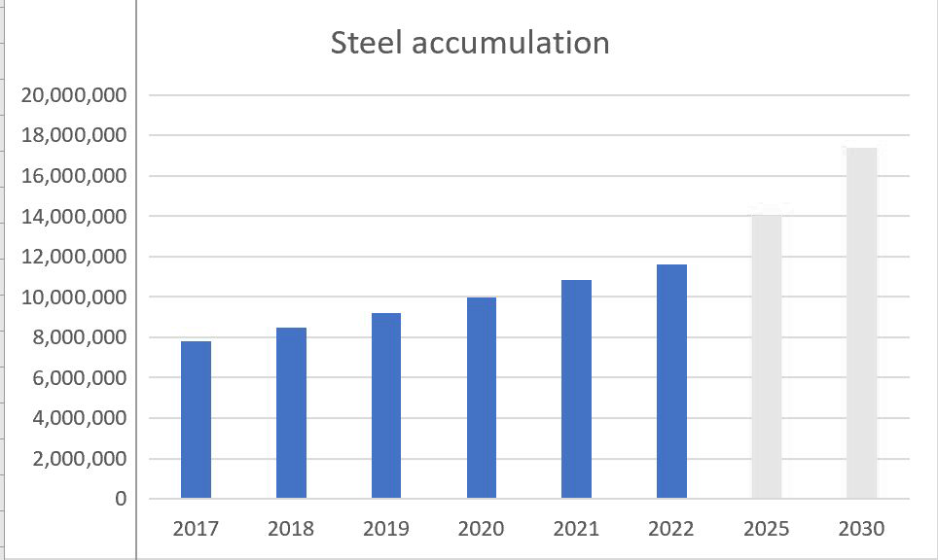
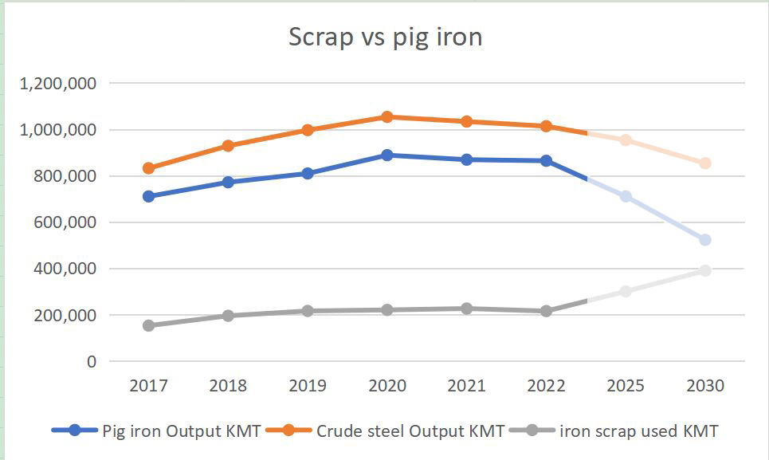
Priority-Rise of EAF
11
2025, 2030 用虚线，2个表都是

Slide 13
Priority-Overseas Investment
12
British Steel | Jingye Group
Dexin Indonesia | Dexin Group
Xinxin Pipe Indonesia | Xinxin Pipe
Serbia Smederevo steel | HBIS
SHOUGANG HIERRO PERÚ S.A.A. | Shougang
Simandou, Guinea | China Minerals, Baowu
Sino Iron, Australia | Citic Pacific
PMC, South Africa | HBIS
Steel service centres in UK, Spain, Italy, Brazi, India | Ansteel

Slide 14
Priority-ESG
13
ESG credit level | Debt default rate
A | 0.28%
B
C
D | 3.58%
Source: Deloitte Green Quantum, from 2015-2022

Slide 15
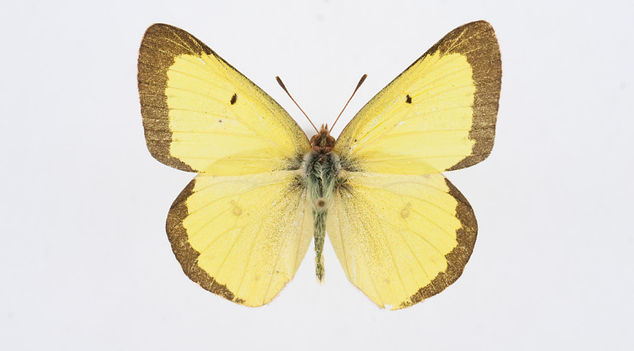
Metamorphosis
14
Higher
Quality
Fair
Yield
Lower
Emmision
Sustainability

Slide 16
millionlink.com Projector：Hill Summer
Develop your data driven business
-- for CRU Ferroalloys 2023 Orlando
Disclaimer
Million Link and/or its subsidiaries endeavour to ensure the accuracy and reliability of the information provided, but do not guarantee its accuracy and reliability and accept no liability (whether in tort or contract or otherwise) for any loss or damage arising from any inaccuracy or omission or from any decision, action or non-action based on or in reliance upon information contained in this presentation.

